Slide 1
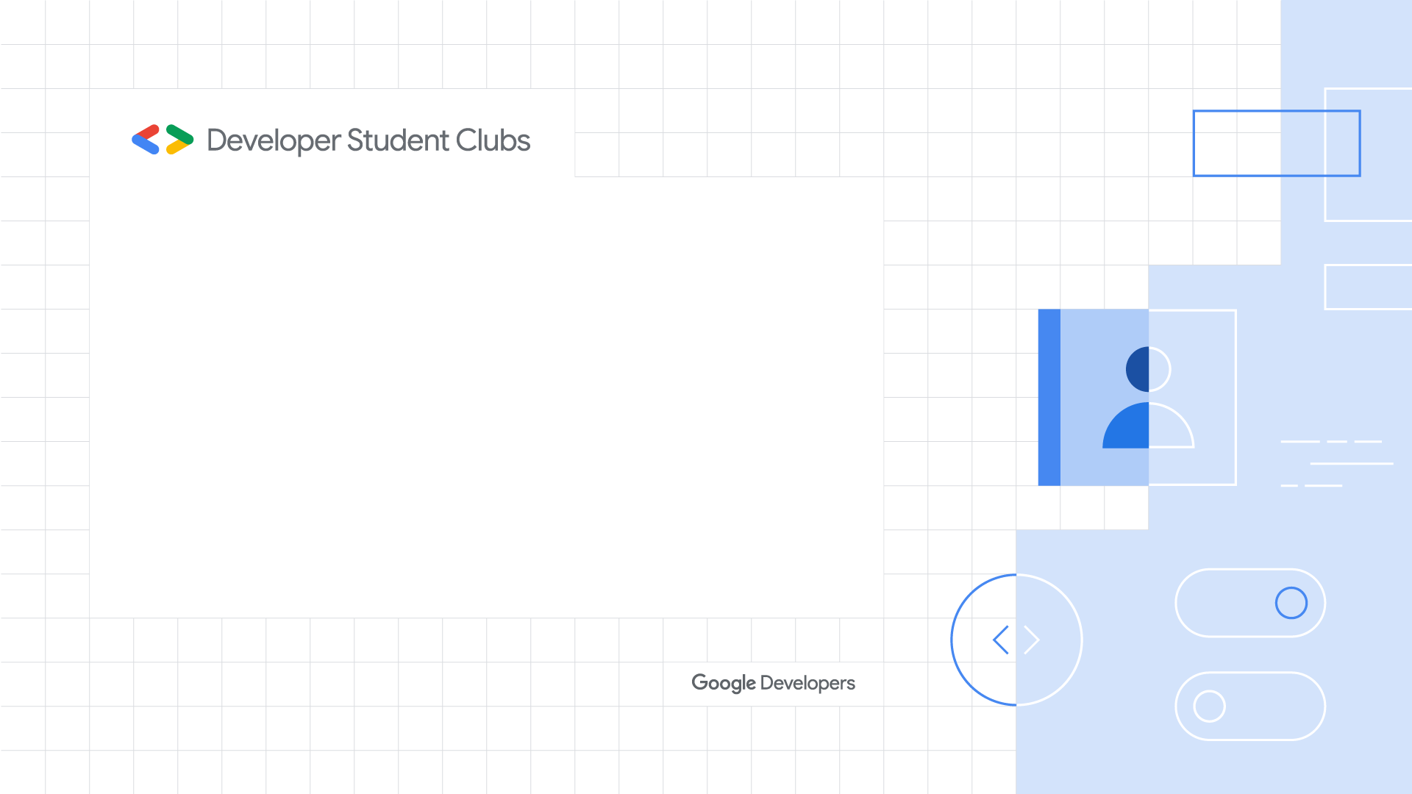
An Introduction to Data Science
Updated 10.22.19

Slide 2

An Introduction to Data Science
"Data is now considered as Electricity for industries and corporations, so those who will not become data driven will face a black out“
~MUB
Information Session by:
------------------------------- Muhammad Umair Baig
MS Data Science in Progress -NED B.E Electrical Engg –NED
Founder of Engineering Digitization (working for democratizing digital revolution)

Slide 3
Topics which are under consideration
Brief History of Data Science
What is Data Science?
Aspiration for becoming Data Scientist
Data Science Life Cycle
Applications of Data Science (Business, Economics and Engineering)
Data Science Roles and Tools
Clarification of myths related to Data Science
Differences to note between Data Science, Data Engineering, Machine Learning, Deep Learning and Artificial Intelligence
Future of Data Science
Best resources to learn Data Science at beginner level

Slide 4
Brief History of Data Science
Data originates from the Latin word, “datum,” which means a “something given” The expression “data” has been utilized since 1500s, however, the modern practice began during the 1940s and 1950s.
1962 – JOHN WILDER TUKEY John Wilder Tukey expounded on a move in the world of statistics in 1962. He alluded to the converging of statistics and PCs, when factual outcomes introduced in hours, as opposed to hand-rolled work that may take a long time of several days or a month.
1974 – PETER NAUR In 1974, Peter Naur wrote the Concise Survey of Computer Methods, utilizing the expression “Data Science,” over and over.
1977 – JOHN WILDER TUKEY John Wilder Tukey composed a second paper titled “Exploratory Data Analysis” in Jan-1977

Slide 5
1996 – INTERNATIONAL FEDERATION OF CLASSIFICATION SOCIETIES members of this society hold a conference with title “Data Science, Classification and Relative Methods”, this title was used first time in the history for any conference.
1997 – C.F. Jeff wu He gave introductory lecture in which he talked about Statistics and called it as a branch of “Data Science”.
2001 – William s. cleveland William S. Cleveland of Bell Labs published a paper, “Data Science: An Action Plan for Expanding the Technical Areas of the Field of Statistics” in which he talked about increasing Computing Power and Data. It was published in International Statistical Analysis .
2002 – the International council for science Council started to publish Data Science Journals in which main concentration was related to highlighting problems which can be solved in Data Science domain. Main topics were; explanation of Data systems, publishing Data systems on internet, Data Science Applications and Law issues related to them.

Slide 6
2005 – National science board They wrote descriptive essay on “Long-Lived Digital Data Collections: Enabling Research and Education in the 21st Century” in which they clearly defined role of a Data Scientist as well as work of Data Science.
2009 – Title Data scientist The title, “Data Scientist” turned into a trendy expression and in the long run a piece of the language. Jeff Hammerbacher and DJ Patil of Facebook and LinkedIn are given acknowledgment for starting its utilization as a trendy expression.
FINAL WORDS The concept of Data Lakes was promoted by James Dixon in 2011. According to his concept, at the point of entry, Data Warehouse pre-categorizes the data, whereas, Data Lake accepts the data by utilizing a non-relational Database i.e. NoSQL without categorizing the data by stores it, which save time and energy as well. According to the statistics shared by the IBM in 2012, about 90% of the digital data had been produced in past two years.

Slide 7
What is Data Science?
Data Science, despite its hype-laden veneer, is perhaps the best label we have for the cross-disciplinary set of skills that are becoming increasingly important in many applications across industry and academia. (JakeVanderPlas, Python Data Science Handbook)
Think Data Science not as new domain of knowledge to learn, but as a new set of skills that you can apply within your current area of expertise. (JakeVanderPlas, Python Data Science Handbook)
It is about extracting useful insights from the data in order to add business value or to solve complex problems.
It is about uncovering hidden information that may be useful to help companies make smarter choices for their business.

Slide 8
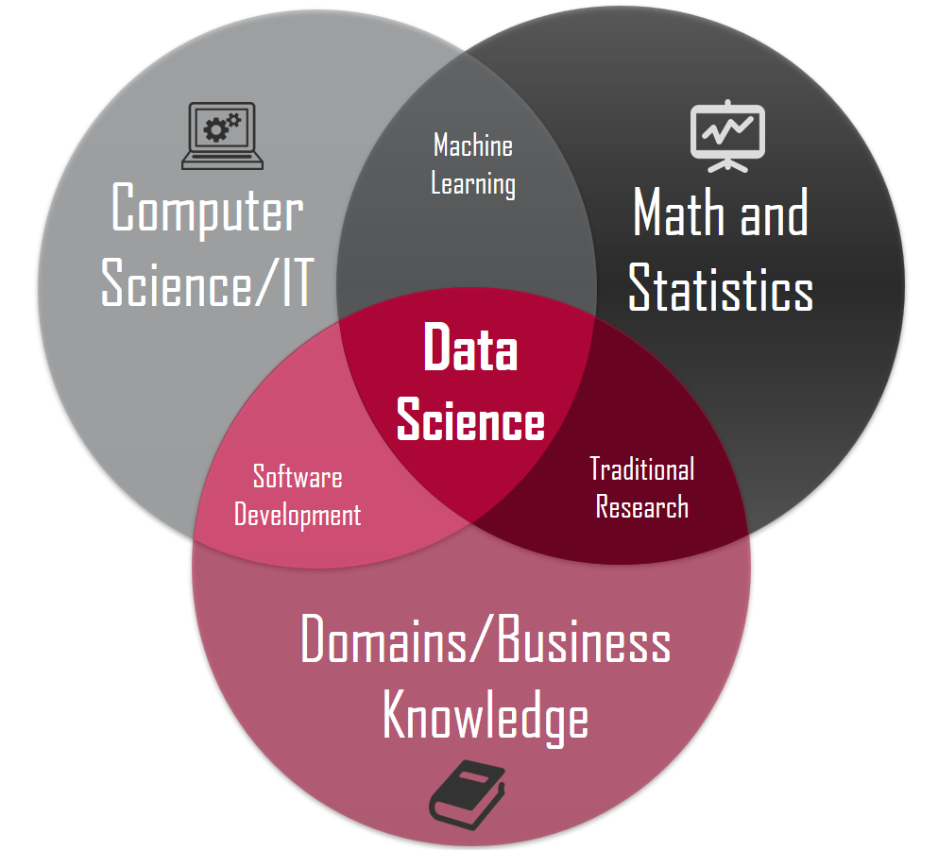

Slide 9
What is Data Science?
Let’s move towards an infographics to explain it further.

Slide 10
Aspiration For Becoming Data Scientist
90% of the data in the world today has been created in the last two years. (IBM,2012)
Data-driven organizations are three times more likely to report significant improvements in decision making (PwC Global Data and Analytics Survey), but less than 0.5% of data is analyzed (MIT Tech Review). The challenge is to rapidly scale a company’s ability to work with data to drive better decisions. (Whitepaper published on DataCamp as “Democratizing Data Science in Your Organization”)
Data Science job is considered as the sexiest(most attractive) job of the 21st century. -Harvard Business Review
We will be reaching in range of zettabytes generation of data in coming years and organizations won’t want it to lose without gaining useful insights.

Slide 11
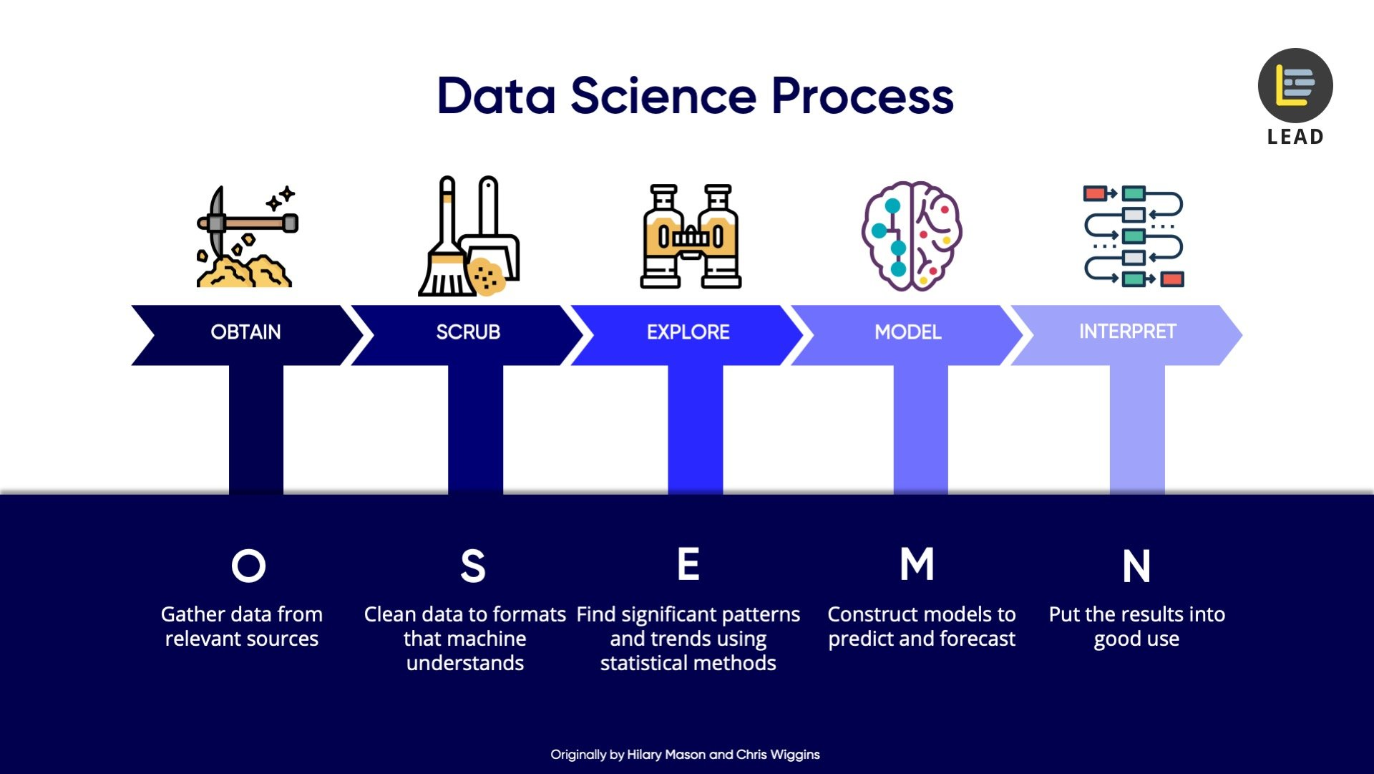
Data Science Project Life Cycle

Slide 12
Applications of Data Science
Presently application of data science is very vast. You can see it everywhere in your daily life. Some prominent examples are given here.
Internet Search Engines
Speech Recognition
Recommender Systems (YouTube, Netflix, Amazon)
Self-driving cars
Image Recognition
Fraud and risk detection
Gaming
Robotics
Airline route planning

Slide 13
Clarification of Myths Related to Data Science
Data Science is not a part or a subset of Software Engineering and Computer Science, however they have intersections with each other as there are many concepts and tools related to Computer Science and Software Engineering which are being used in Data Science.
Data Science is not about making beautiful infographics.
Data Science is a name of Statistics solely, is also not a good explanation of Data Science because Data Science goes beyond to that.
Data Science is not about Data Management, Data Quality, Data Encapsulation, Data Encryption solely.
Data Science is neither a subset of Machine Learning, Artificial Intelligence and Data Engineering, however Data Science has subsets of all these domains.

Slide 14
Differences to Note Between Data Science, Data Engineering, Machine Learning, Deep Learning and Artificial Intelligence
Data Science
AI
Data Engineering
ML
DL

Slide 15
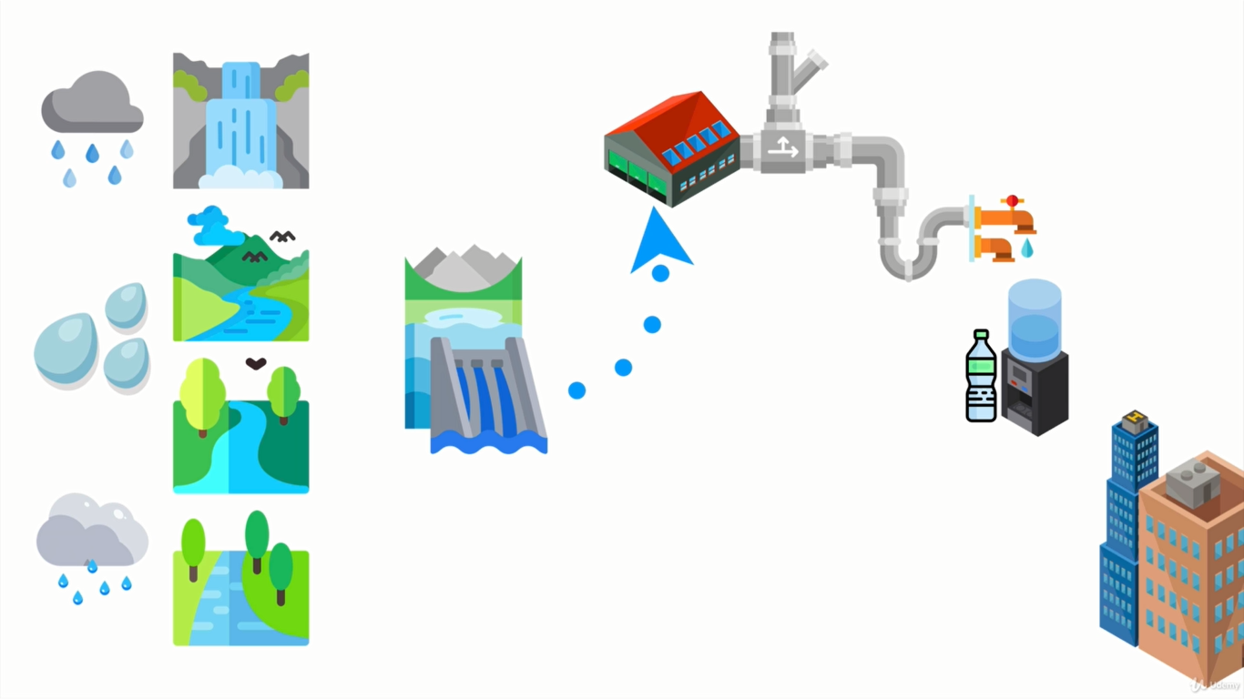
Data Scientist vs Data Engineer (Explanation with analogy)

Slide 16
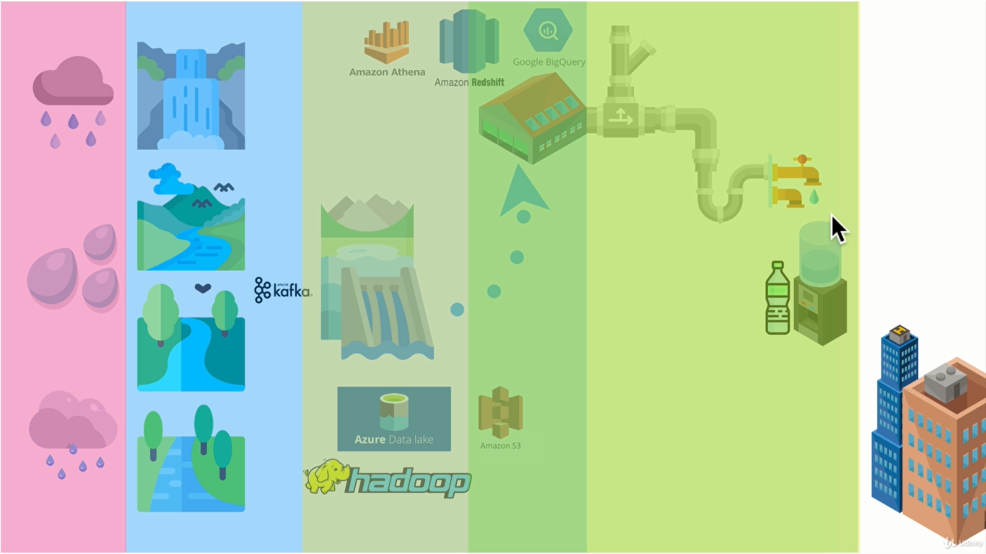
Data Scientist vs Data Engineer (Explanation with analogy)

Slide 17
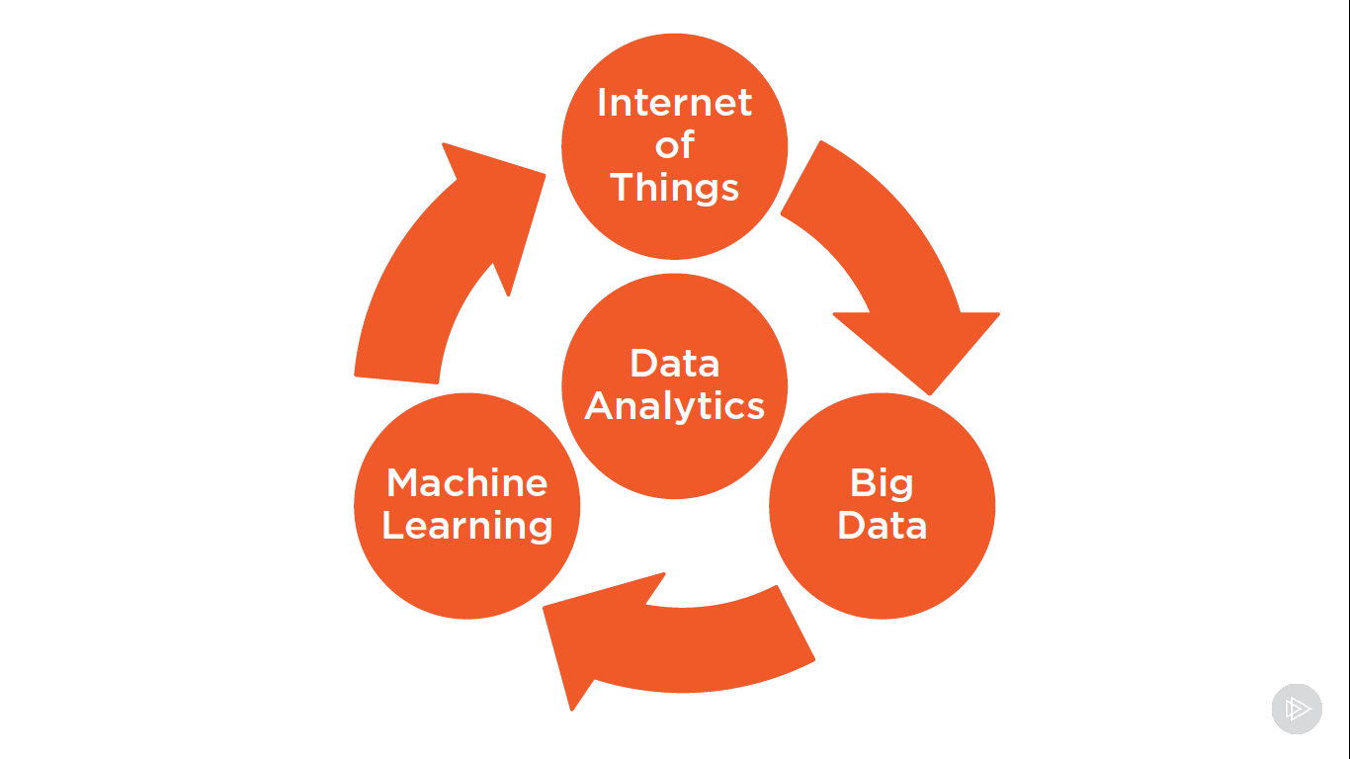
Future of Data Science & Analytics

Slide 18
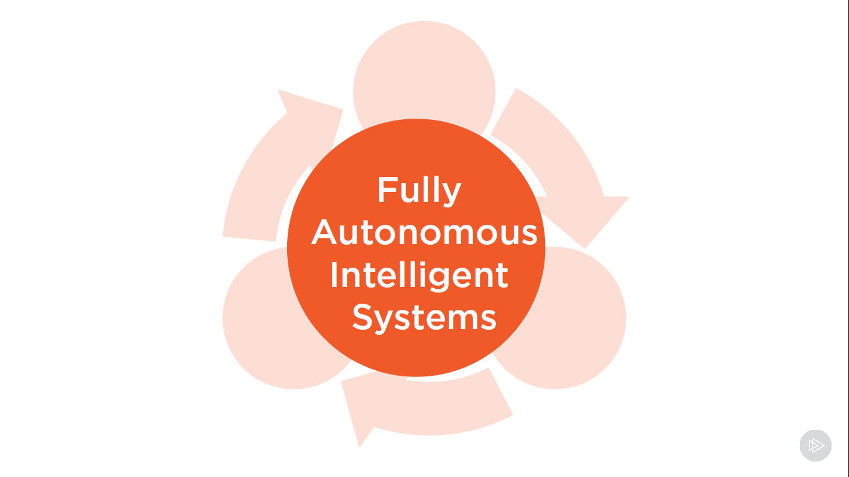
Future of Data Science & Analytics

Slide 19
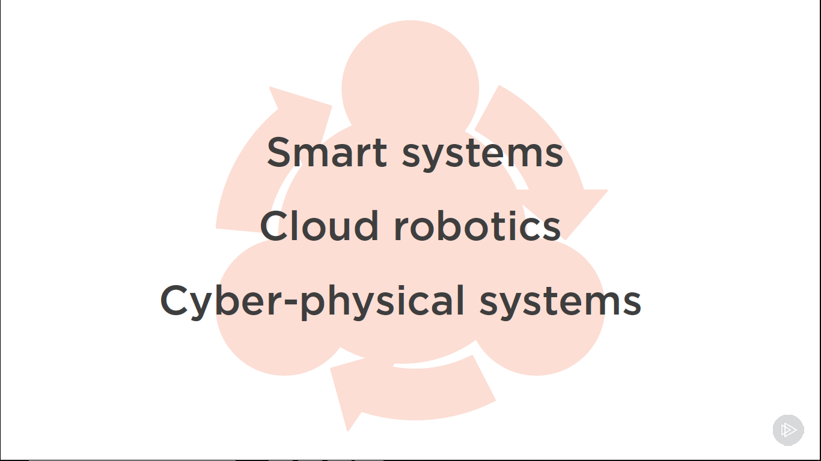
Industrial Revolution 4.0
Industrial Revolution will not replace humans but it seems clearly that it will replace those who will not have skills set required to adjust in the revolution.

Slide 20
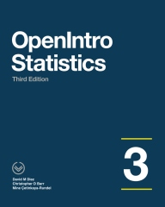
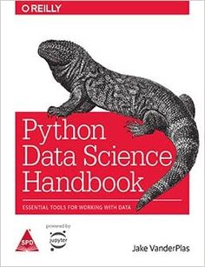
Best Resources To Learn Data Science at Beginner Level
I recommend to read and understand these two books at Beginner level

Slide 21
References
Python Data Science Handbook by Jake VanderPlas
An Introduction to Data Science by Dr Zeeshan ul Hasan Usmani
https://www.datacamp.com/community/
https://365datascience.teachable.com/
https://www.pluralsight.com/
https://towardsdatascience.com/data-science-life-cycle-101-for-dummies-like-me-e66b47ad8d8f

Slide 22
Thank you for showing patience
One can like my Facebook page named as “Data Science Portal”
One can join my Facebook Group named as “Engineering Digitization” where I usually share free resources for online learning

Slide 23
Thank you!

